Slide 1

MVC – Models and Entity Framework
By: Munish Arora

Slide 2
What we will cover?
In this, we will cover
What are Models
Types of Models
Introduction to Entity Framework Core
Working with Entity Framework Core
Entity Framework DB First
Deploying App to Azure
Entity Framework Code First
Entity Framework to invoke Stored Procedures
Linking Controllers
Model Binding

Slide 3
What are Models
The MVC Model contains all application logic (business logic, validation logic, and data access logic), except pure view and controller logic.
With MVC, models both hold and manipulate application data.
A model in the MVC pattern can be classified further as either
Data model
Business model or
View model.
Each of the different model types has a specific purpose

Slide 4
What are Models
Data Model
The objects in the Data Model represent classes that interact with a database to store and retrieve the data.
Normally, you can think of the data model as the set of classes created by tools such as Entity Framework (EF).
Business Model
The classes in the business model normally implement functionality that represents business rules or processing (for example, calculation of shipping cost for a shopping cart item).
As part of the processing, the business model classes can interact with the data model classes to read or save data in the database.

Slide 5
What are Models
View Model
The View Model classes provide information passed in from controllers to views, so that the views know what to render in the user’s browser.
For example, a view model class can contain product information that is used by a view to display the product name, price, and images.

Slide 6
Creating the Data Model
How is it easier by using the Data Model?
Working with classes is far easier than working with database tables [ because object-oriented languages such as C# or VB.NET are not designed to interact directly with databases]. Instead, an abstraction layer is used to send commands to the database.
You can concentrate more on writing application logic rather than doing database related stuff, so development time and effort is greatly reduced.
With Data Model, you are not required to open connection, set and execute the commands, rather data model (/the classes in the data model) do this for you.

Slide 7
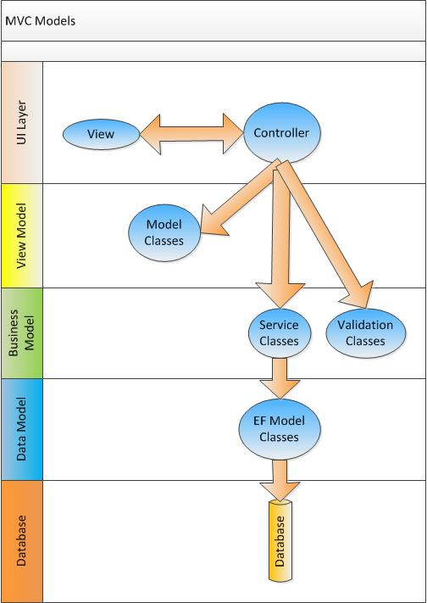
Data Model
Here in a quick example, we have
UI Layer, which contains view and controller
Controller may
interact with Model classes, and pass this to view
make use of Validation classes for validation of data
Interact with Service classes to interact with Entity Framework classes
Entity Framework classes in turn interact with database

Slide 8
Entity Framework
Entity Framework is an object-relational mapper (O/RM) for .NET.
Entity Framework 6
Entity Framework 6 (EF6) is a tried and tested data access technology.
It was first released in 2008, as part of .NET Framework 3.5 SP1 and Visual Studio 2008 SP1.
Starting with the 4.1 release it has shipped as the EntityFramework NuGet package. EF6 runs on the .NET Framework 4.x, which means it runs only on Windows.
Entity Framework Core 6.0
Entity Framework Core (EF Core), open source, is a complete rewrite of EF6 that was first released in 2016, and is much more lightweight than previous versions
It ships in Nuget packages, the main one being Microsoft.EntityFrameworkCore.
EF Core is a cross-platform product that can run on .NET Core or .NET Framework.
EF Core was designed to provide a developer experience similar to EF6. Most of the top-level APIs remain the same, EF Core will feel familiar to developers who have used EF6. The developers can still work with DbContext, DbSet, etc.
Pls. refer to https://docs.microsoft.com/en-us/ef/efcore-and-ef6/ for details

Slide 9
Model: Entity Framework Core
Model
With EF Core, data access is performed using a model.
A model is made up of
Entity classes and
A context object that represents a session with the database, allowing you to query and save data
You can generate a model
from an existing database [Database First approach]
hand code a model to match your database, or
use EF Migrations to create a database from your model, and then evolve it as your model changes over time [[Code-First First approach] .

Slide 10
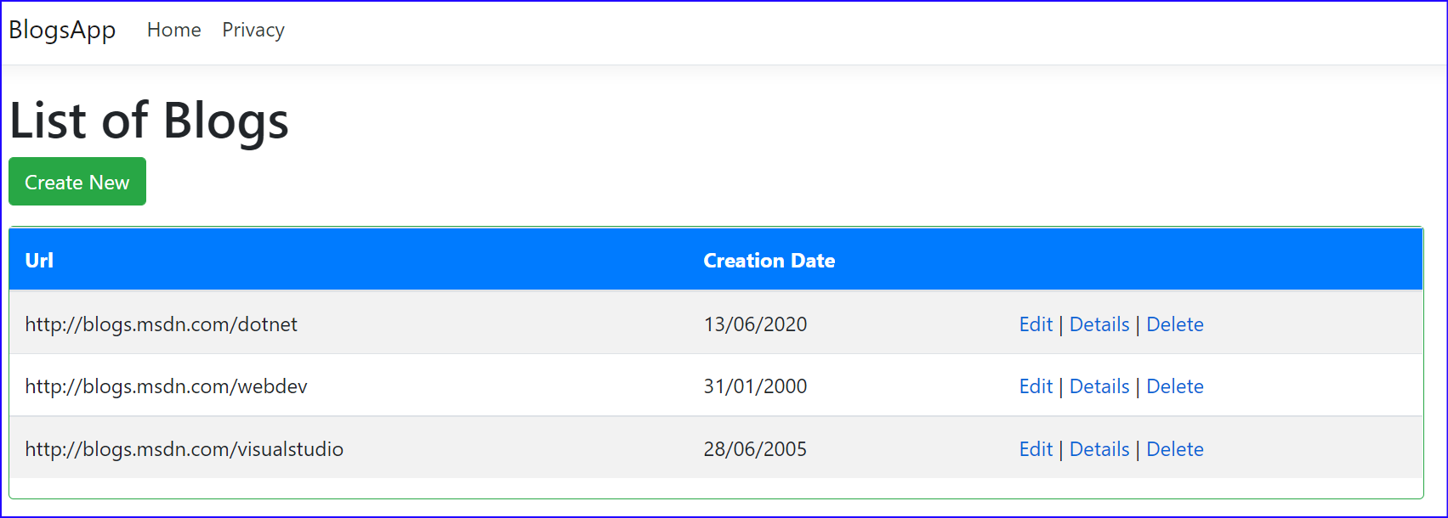
Entity Framework: Blogs
Create BlogsApp using Database First approach

Slide 11
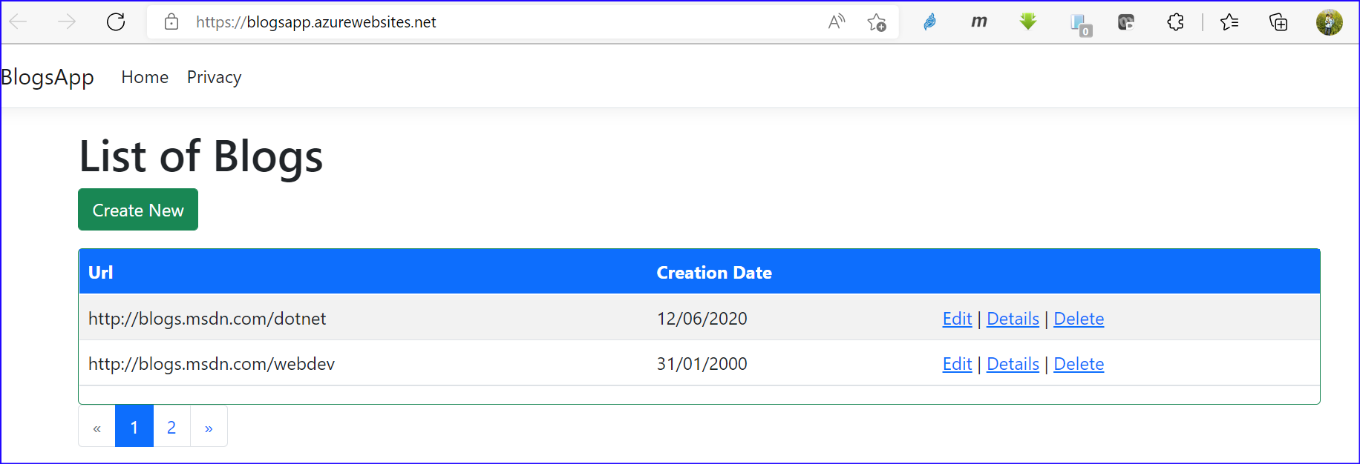
Entity Framework: Blogs App
1 Blogs App
1.1 Deploying to Azure
1.2 Debugging Azure App
1.3 Paging
1.3.1 Adding Paging
1.3.2 Adding Pagination via TagHelper

Slide 12
Entity Framework: Code First Migrations
Sometimes you may have a bug in your code that has let corrupt or incorrect data get into your database. This can give you unpredictable results, and you can end up dropping and creating a database multiple times.
When this happens, you are sometimes faced with the undesirable task of getting data back into the database to test your bug fixes.
In the past this was a painstakingly slow process, since you had to add all of your test data back into the database.
With Code First Migrations, you can easily seed the database and do the testing.

Slide 13
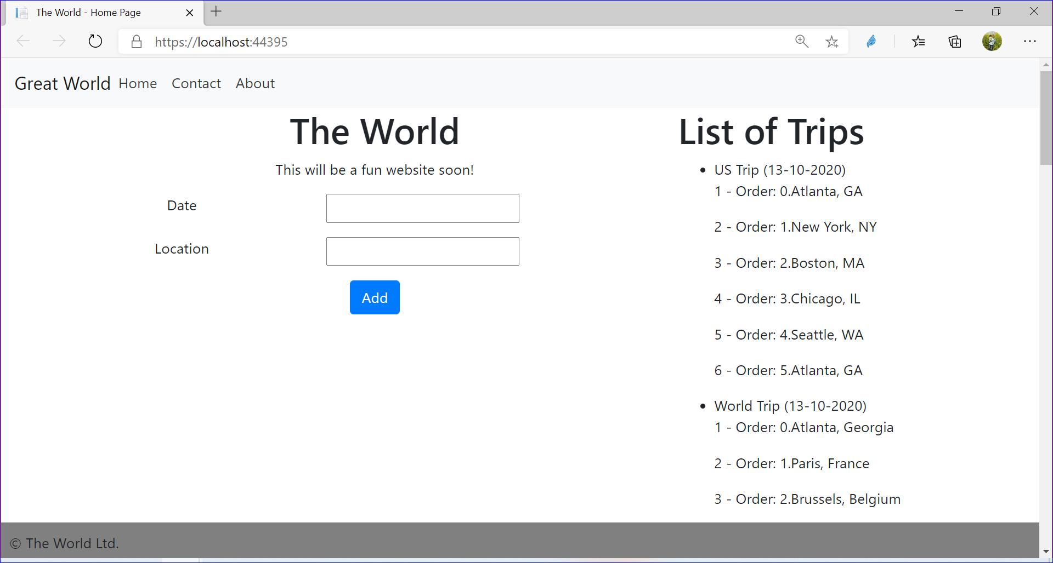
Entity Framework: Viewing Trips
Use code first migration to
Create the structure in database and
Seed | Populate the database and
Display the maps information

Slide 14
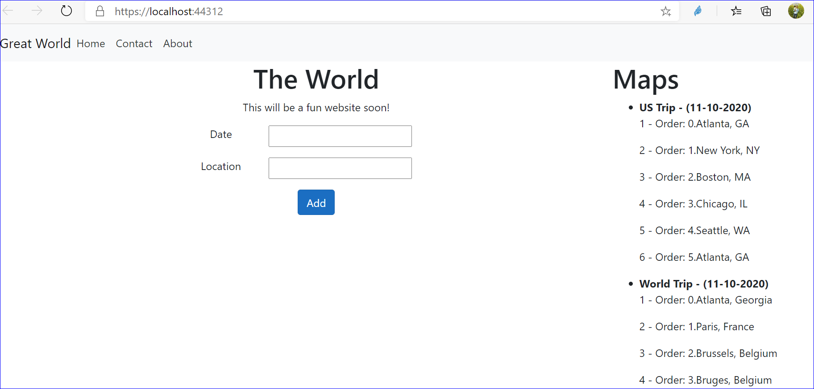
Entity Framework: Viewing Trips
Use Repository pattern to display the maps information

Slide 15


Knowledge check
Which of the following is true?
In code first approach we will first create entity classes with properties defined in it. Entity framework will create the database and tables based on the entity classes defined.
In the database first approach, the database and tables are created first. Then the programmer can create the entity data model using the created database
The changes made to underlying tables in the code can be applied to the code first approach by running Add-Migration and Update-database command in Package Manager Console
The changes made to underlying tables in the code can be applied to the database first approach by running Add-Migration and Update-database command in Package Manager Console
We can have multiple DBContext classes for connecting to database in asp.net core application
True
False

Slide 16
Model Binding
When a user submits a form in a strongly typed view, ASP.NET MVC automatically examines the HttpRequest object and maps the information sent to fields in the model object. That way you only have to examine the model object for the information being sent. This process of mapping the information in the HttpRequest object to the model object is called model binding.
The benefits of model binding are huge; for example:
No manual code is needed to extract the data from the HttpRequest object, which avoids coding errors.
Data type conversions happen automatically.
Data can be easily validated

Slide 17
Default Model Binding
By default, this model binder searches four locations
E.g. if you have the url like http://localhost:40425/Home/Index/1, the DefaultModelBinder looks for a value for our id parameter (in order) as follows:
Request.Form["id"]
RouteData.Values["id"]
Request.QueryString["id"]
Request.Files["id"]
Source | Description
Request.Form | Values provided by the user in HTML form elements.
RouteData.Values | The values obtained using the application routes.
Request.QueryString | Data included in the query string portion of the request URL.
Request.Files | Files that have been uploaded as part of the request

Slide 18
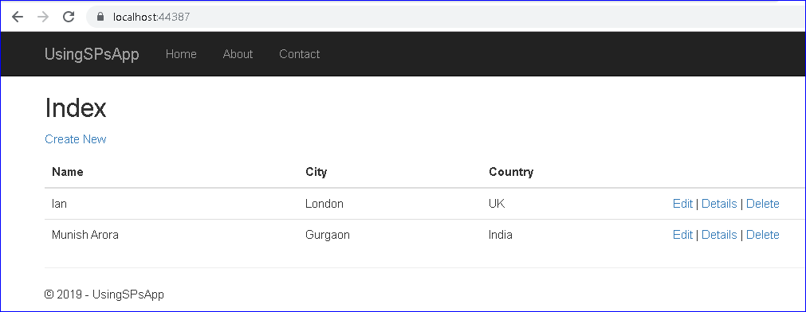
Invoke Stored Procedures
Use Entity Framework to invoke Stored procedures in SQL Server

Slide 19
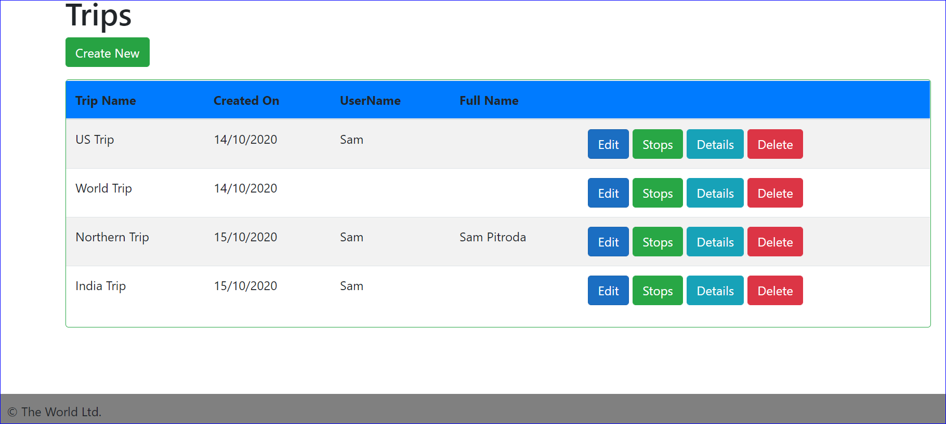
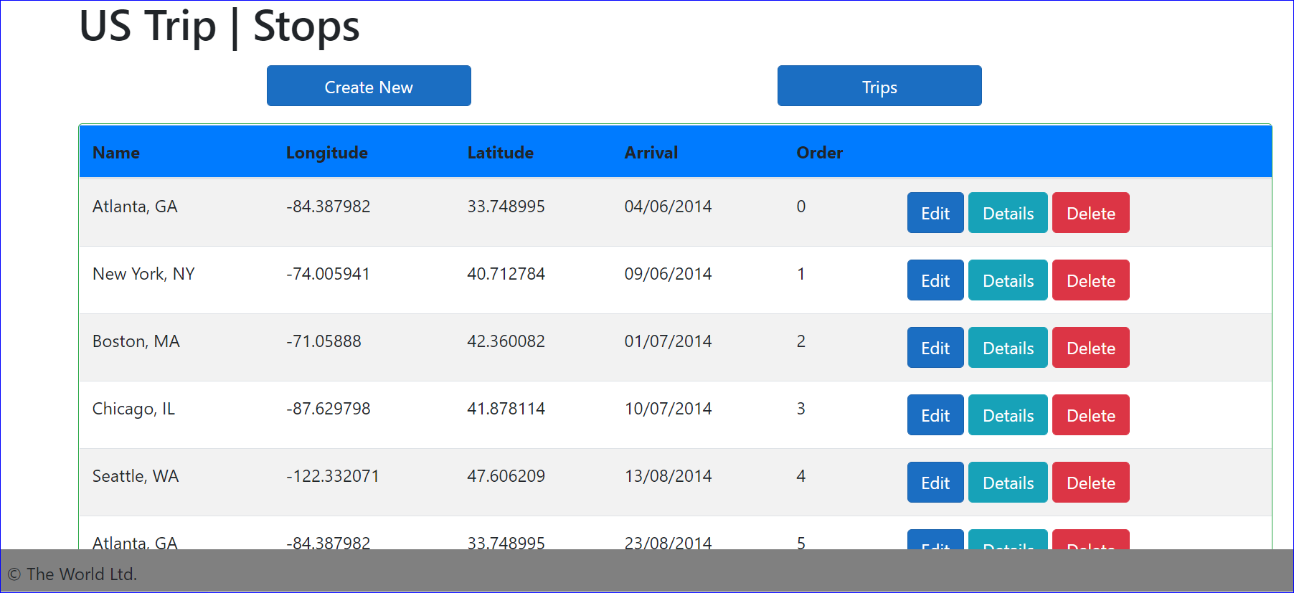
Displaying Trips n Stops
Use Entity Framework to implement CRUD functionality for Trips and corresponding Stops

Slide 20
Summary
In this, we covered
What are Models
Types of Models
Introduction to Entity Framework Core
Working with Entity Framework Core
Entity Framework DB First
Deploying App to Azure
Entity Framework Code First
Entity Framework to invoke Stored Procedures
Linking Controllers
Model Binding

Slide 21
THANK YOU!

